Slide 1
Acute Care from the PTA. Perspective by Cynthia Travis, PTA 9-26-25
Subtitle

Slide 2

My why?

Slide 3
My Bio
Graduated Davenport University 2000 & University of Memphis 2011
Worked in Michigan, Washington state & TN. All facilities in acute care.
APTA member since 2006
Received my Advance Proficiency Pathway for PTA’s in Acute Care in 2021
Current PTA SIG Vice Chair & APTA Memphis Treasurer
Clinical Instructor
Round in Multi Disciplinary rounds in ICU
Served as an Educator on Early Mobility in the ICU for the RN residency program
Chair for the Striving Towards Leadership Program
I currently work at Methodist North Hospital in Acute Care & Regional One Trauma Center in PRN

Slide 4
Conflict of Interest Disclosure
I have no relevant financial relationships or potential conflicts of interest to disclose. I’m receiving no financial compensation or gain for this presentation.

Slide 5
Strong Beliefs I function under
Safety first! ( Jossie King Patient safety program (7.28) )
Caso Josie King - Hospital Johns Hopkins - YouTube
Communication & Listening is absolutely VITAL!
Give them the pickle! (- GIVE EM THE PICKLE by Bob Farrell)
What if it was you or your family?
Think wholistically
Hold the line or move it forward ( if you can’t then document why & consider a new approach or different therapist)!
Absolutely avoiding the mindset … “I’m just the little PTA.”

Slide 6
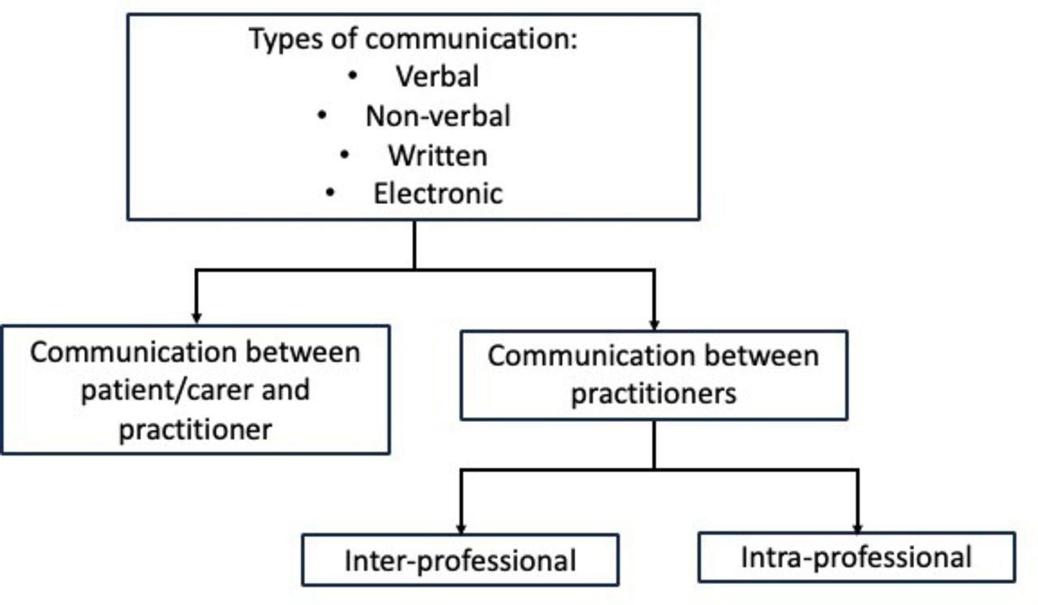
Communication is Key! https://www.who.int/teams/integrated-health-services/patient-safety/policy/global-patient-safety-action-plan How does communication affect patient safety? Protocol for a systematic review and logic model | BMJ Open e085312.full.pdf
1 out of 10 patient world wide are harmed & more than 3 million death a year due to safety incidences.
Research show incidents can be multi faceted, but ineffective communication contributes to adverse care outcomes.

Slide 7
World Health Organization Safety & Eliminating Harm Initiative
https://www.who.int/teams/integrated-health-services/patient-safety/policy/global-patient-safety-action-plan
Download a free Global Patient Safety Action Plan 2021-2030
The plan core initiatives that support
Policies to eliminate avoidable harm.
Highly reliable systems
Safety of clinical practices
Patient & family engagement
Health care workers education, skills & safety
Information, research & risk management
Synergy, partnership & solidarity

Slide 8
Safety Tenants of Behavior
You see something say something.
Gather your supporting evidence & immediately notify the PT. Then move forward with actions.
Arch it up & chart that you did so
If it isn’t taken seriously continue to arch, it up higher
Your patient’s & families deserve you to set aside any fear of repercussions.
Your license also will be protected by you following this framework.

Slide 9
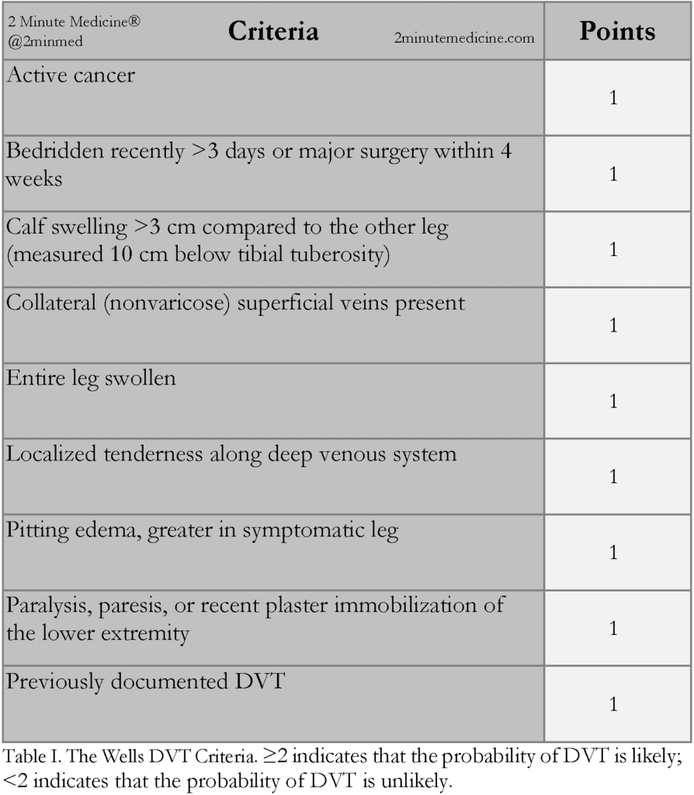
Example of Arching it up
Your patient shows signs of a DVT ( No a positive Homans isn’t enough)
You should figure a quick Well’s Prediction Score
https://www.2minutemedicine.com/the-wells-dvt-criteria-a-validated-clinical-prediction-model-for-the-detection-of-deep-vein-thrombosis-classics-series/
Then follow the arching it up strategy!

Slide 10
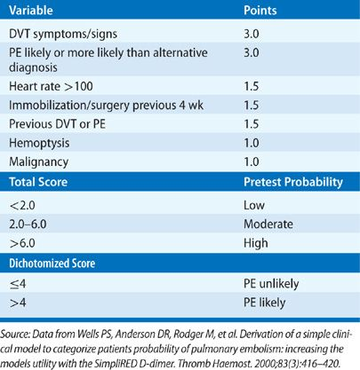
Well Prediction for PE
https://thoracickey.com/pulmonary-thromboembolic-disease/

Slide 11
Topic to be covered today ( from the perspective of the adult acute care setting from Med surg , ICU, & rehab ready)
Chart Review ( PT eval, other rehab notes, meds, vitals, labs, imaging, consultants, orders etc.)
Planning your treatment
Strategy for getting informed consent ( aka no refusal)
Strategy for success at the bedside
Early mobility is key especially in the ICU
Trends for the future of early mobility
Always being alert to things that the PT. should be notified about
Educating other & set the patient for successful return to bed
Discharge planning & frequency support : Beyond the eval & re-eval. The AM-PAC – the latest tool in documentation

Slide 12

Chart Review as a PTA ( start in the direction it makes sense for you)
Start with the PT. eval
Last PT. treatment note
Vitals
Labs
Orders ( especially test & procedures)
Doctors & other care providers notes ( OT, ST , Case Managers , Social work, Dietician )

Slide 13
Planning your treatment: PT. Evaluation Chart Review Key points Beyond Strength & Goals
What the patient came in complaining of .
What was the diagnosis or are they still looking?
Current test , labs, & vitals and those noted upon the eval
The patients' prior level of function
The patient's family support & resources ( no insurance & no family)
The patient home or dwelling
What does the patient enjoy & what is their goal
Patients' cognitive status, vision, & hearing

Slide 14
Treatment Planning & Strategy : When should PT. Tx. Be held- Most commonly seen
Always consider context & speak to the PT. if in question ( also notify PT. of any holds)
Major change in medical status
Fall ( not yet reported to doctor for clearance & no films done)
Lab values to high or to low
If you see test ordered that may signal a DVT or PE ( D-dimer, VQ lung scan, LE. Doppler )
Cardiac Labs
Stat ABG’s
Lumbar Punctures
Cardiac Cath ( depends on the access)
Meds given that would potentially be dangerous if pt. is moved ( Levophed , pressors, TNK)
A new surgical procedure note noted on the eval or any new symptoms especially with vitals or pain that hasn’t been noted ( think trauma, c/o pain that could be DVT , or vitals showing sign that could be a PE )
Signs of new unaddressed Sepsis

Slide 15
You’re now entering the room….
Knock & say the patients name & match the wrist band
Acknowledge everyone in the room, smile & be respectful
Tell them who you are & why you’re there
Smile & shake your head yes as you get consent
Take note of what your see & circle around the bed
Ask consistent intake questions ( how are you feeling today, did you eat, are you in pain, have you had pain medication or have you had your morning meds)
Reflect to them what you read for their last rx. Or eval to clarify & talk about what you had in mind for your rx.
Always ask…Do you need to go to the bathroom? It will save you issues later!
Lower your physical position when you can & keep their modesty

Slide 16
Planning & Strategy: Choosing the rite level of exercise & approach to your treatment
Again: Hold the line or move it forward
1st treatment you may need to first allow them something achievable
If you get a sense they’ll highly motivated, you might for the hardest thing first & talk with them about this or if energy conservation is a issue
Adjust your level of encouragement as appropriate (don’t be patronizing)
Break down the task based on their goal & restate what you read
Recognize possible physiological barriers
Patient Centered Care ( prioritize the patients needs, values & preferences)

Slide 17
A Study revealed Common strategies for patient motivation depended on a few factors
https://academic.oup.com/ptj/article/103/6/pzad034/7107869?login=true
Individual mental health condition
Physical Problems
Level of cognitive function
Personality
Age & Interests
Physical Environment

Slide 18
In Planning we must acknowledge the Physiological aspect that plays a part in successful PT.
https://www.researchgate.net/profile/Lindsay-Ross-Stewart/publication/328887156_Knuth_Ross-Stewart_Brent_Salerno_2018/links/5be99815a6fdcc3a8dd1b083/Knuth-Ross-Stewart-Brent-Salerno-2018.pdf
Therapist acknowledge many times they see limiting factors of : Stess /anxiety, depression & pain management as well as biological factor such as disease , injury & condition limit success. Also the patient feelings, thoughts & lack of social support play a large part .
Some solutions that can be offered in acute care: confer with the nurse, the evaluating PT, the MD, consult Pastoral care, do you have Physiologist on staff?
More solutions: Point out the positive after every treatment, set goals for the next treatment, get your patient into natural light, help set a routine, do treatments when patients choose or when family is present or not present.

Slide 19
More to Strategies for success-
Do you need a new set of reference vitals
Always tell people what your going to do before you do it ! It just doesn’t fail!
Move back those covers
Can you see everything & do you know what it is?
Organize your move & plan your landing
Always have a back up plan when trying something knew
Make then prove themselves- Egress Test-Appendix C Modified DET Clinical Pathway.pdf
Lower your position when you can
Cue for intention( ie. When you need power a bigger move cue it that way)

Slide 20
Now you’ve begun your treatment….
When trying something new give yourself & the patient a safety back up plan.
Do you have the lines where your want them for safe ease of movement?
If it’s too many lines as for disconnection, consolidation or another set of hands
Get family involved in simple but safe tasks
Always look at your patient how they look will tell you a lot!
Be reasonable with your expectations but be brave!

Slide 21
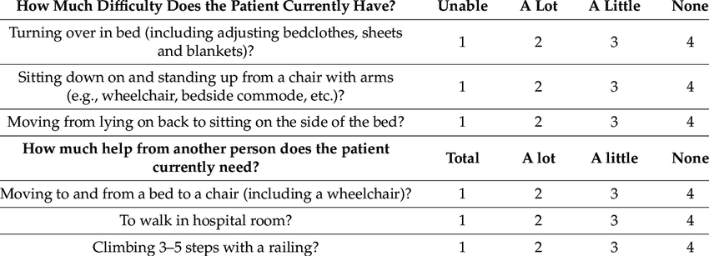
Functional Mobility Assessment -AM-PAC ( 6-Clicks)
AM-PAC – Activity Measure for Post-Acute Care
Activity Measure for Post-Acute Care (AM-PAC) – "6 Clicks" Inpatient Short Forms | APTA ( instructions how to score the AM-PAC)
AM-PAC “6-Clicks” Functional Assessment Scores Predict Acute Care Hospital Discharge Destination | Physical Therapy | Oxford Academic ( AM-PAC for Discharge planning )
Association of Physical Therapy Treatment Frequency in the Acute Care Hospital with Improving Functional Status and Discharging Home – PMC ( evidence of high frequency the more like home is the discharge disposition & increased functional improvement as well as support for rehab staffing)
Printable AM-PAC compliments of Med Bridge
https://www.medbridge.com/resources/access?name=medbridge-ampac-score-chart.pdf

Slide 22
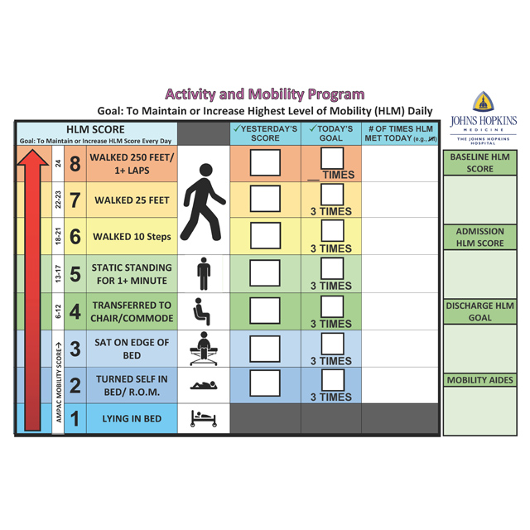
John Hopkins Highest level of Mobility score (JH-HLM)
Performed by Physical therapists & Nursing Staff
Physicians, Case Managers & “other members” of the rehab team can contribute info
Excellent intra-rater reliability is said to be comparable to the Am-Pac
Rated high valid & reliable
Resource for use: https://www.hopkinsmedicine.org/physical-medicine-rehabilitation/education-training/amp/toolkit

Slide 23
Strategy for success at the bedside
The IMS and the JH-HLM are both used to track the highest level of patient mobility achieved in a 24-hour or shift-based time frame. They require minimal training and minimal equipment, are free to administer, and generally take <1 minute to complete.
The IMS and the JH-HLM can be administered by any member of the interprofessional health care team including, but not limited to, physical therapists, occupational therapists, physical therapy assistants, certified occupational therapy assistants, nurses, certified nursing assistants, respiratory therapists, advanced practice providers, physicians, and other support personnel.
Sourced: Core Set of Outcome Measures to Assess Physical Function for Adults Participating in Physical Therapist Treatment in the Hospital: A Clinical Practice Guideline | Physical Therapy | Oxford Academic
The AM-PAC was developed using this framework : Journal of Acute Care Physical Therapy
Support for the use of OMs in acute care physical therapy practice is also provided in the 2015 edition of the Core Competencies for Entry-Level Practice in Acute Care Physical Therapy that endorses the use of OMs to determine the patient's appropriateness for rehabilitation and to guide interventions.¹⁶ A second potentially contributing factor is the recognized importance of OMs by third-party payers such as clinicians required to justify the need for post acute care inpatient rehabilitation.^{11,17,18}

Slide 24
DeMorton Mobility Index (DEMMI)
https://pmc.ncbi.nlm.nih.gov/articles/PMC2551589/\
https://academic.oup.com/ptj/article/96/10/1658/2870254
Designed for the Older Adult
May not capture information well for the very debilitated adults
Used in the ICU setting

Slide 25
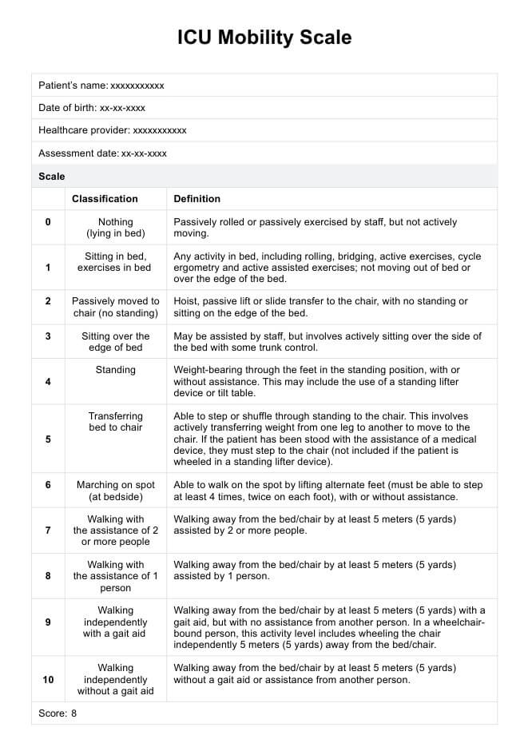
ICU Mobility Scale (ICU-MS)

Slide 26
You’re treatment wrap up
Leave patients sitting up for pulmonary toileting if possible.
Set them up close to the edge of the bed
Is a safety alarm needed & do you know their fall risk level?
Notify the nurse & medical assistant of the patients ending position ( at minimum one of them) always document this!
Always leave the call light & all the patients needs within reach & document it!
Discuss the safety expectation with the patient & family.
Set up the next treatment by talking about the next treatments goals. Let them have input.

Slide 27
Being an advocate & pushing for the hard work!
The team approach is best along with early mobility
Implementation of an Interdisciplinary AACN Early Mobility Protocol | Critical Care Nurse | American Association of Critical-Care Nurses
Low adverse effects of early mobility
Safety of Patient Mobilization and Rehabilitation in the Intensive Care Unit. Systematic Review with Meta-Analysis | Annals of the American Thoracic Society

Slide 28
Beyond a beginner Early mobility in the ICU
The awake & walking ICU: Innovation in Delirium - The Awake and Walking ICU. A testimonial by Kali Dayton
Getting nursing in on the mobility process is key in acute care. Rehab can not be the only ones to mobilize: https://journals.lww.com/nursingmanagement/fulltext/2023/03000/early_and_progressive_mobility_in_a_community.5.aspx

Slide 29
Resources
2023_update_lab_values_inter.pdf
HF guidelines (002).pdf

Slide 30
Thank you for joining me today!
Text or email me any time!
901-921-1731
Cynthia.travis@mlh.org

